Slide 1
Ununoctium
Mr. Lim
DECORATIONS!!!

Slide 2
Page 1-Birth Certificate stuff
Name: Ununoctium
Nickname: Uuo
Birth date: July 3, 2006
Birth weight: 294 amu
Birth height: 118 amu
Race: Non-metal/Noble Gas
Attending Physician: Joint Institute for Nuclear Research & Livermore National Laboratory
Gender: Gas
Place of Birth: Great Britain
Personality: Boiling point = 170* F

Slide 3
Pronunciation Rebus
Ununoctium
Oon-oon-OCT-ee-um

Slide 4
Family Members
Family Name: Noble Gases
Address: 7 Livermore Drive
Brothers and Sisters: Helium, Neon, Argon, Krypton, Xenon, and Radon

Slide 5
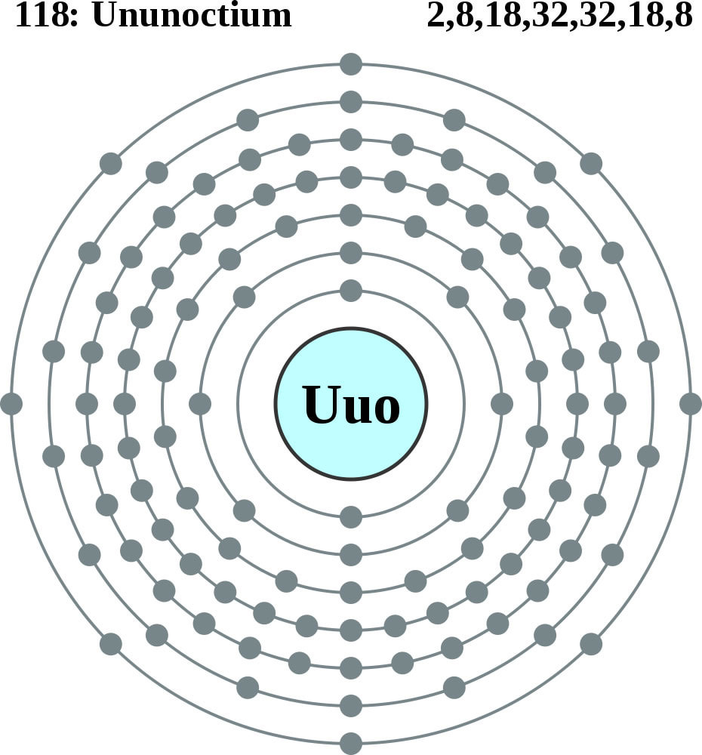
Bohr Model

Slide 6
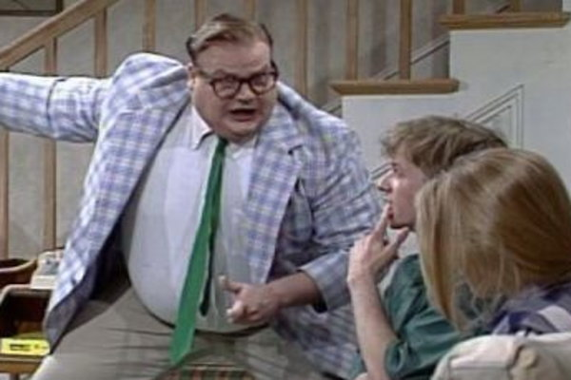
Career
I live in a van down by the river☹
I’m unemployed

